Slide 1
Mental set
Find the Mean of the follow datasets
1, 2, 3, 4, 4, 4
31, 36, 36, 32, 32, 33
5.1. 5.6, 5.6, 5.2, 5.2, 5.3
-11, -16, -16, -12, -12, -13
Notes:
Answers 1. 3, 2. 33.33, 3. 5.33, 4. -13.33

Slide 2
24
7
30
Date
Mean and Standard Deviation
EQ – What is Standard Deviation and how does it relate to Mean
5
Notes:
Lesson objective (EQ)

Slide 3
Lesson objective
By the end of this lesson you will be able to;
Understand the relationship between Mean and Standard Deviation.
Be able to calculate Mean and Standard deviation manually and using technology
Notes:
Lesson

Slide 4
Success Criteria
You will know you are successful in achieving the objective by…
Understanding the relationship between Mean and Standard Deviation.
Being able to calculate Mean and Standard deviation manually and using technology

Slide 5
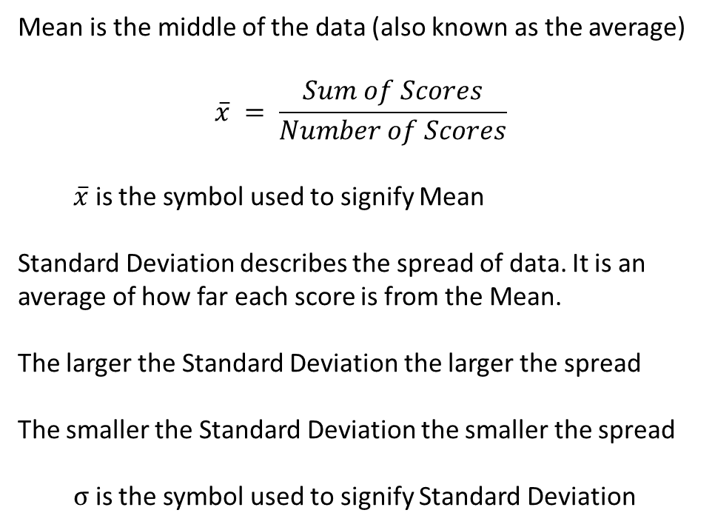
24
7
30
Date
Mean and Standard Deviation
EQ – What is Standard Deviation and how does it relate to Mean
Mean is the middle of the data (also known as the average)
$$\overline{x} = \frac{Sum of Scores}{Number of Scores}$$
$\overline{x}$ is the symbol used to signify Mean
Standard Deviation describes the spread of data. It is an average of how far each score is from the Mean.
The larger the Standard Deviation the larger the spread
The smaller the Standard Deviation the smaller the spread
σ is the symbol used to signify Standard Deviation
What is Mean
What is Standard Deviation
5
Notes:
Input

Slide 6
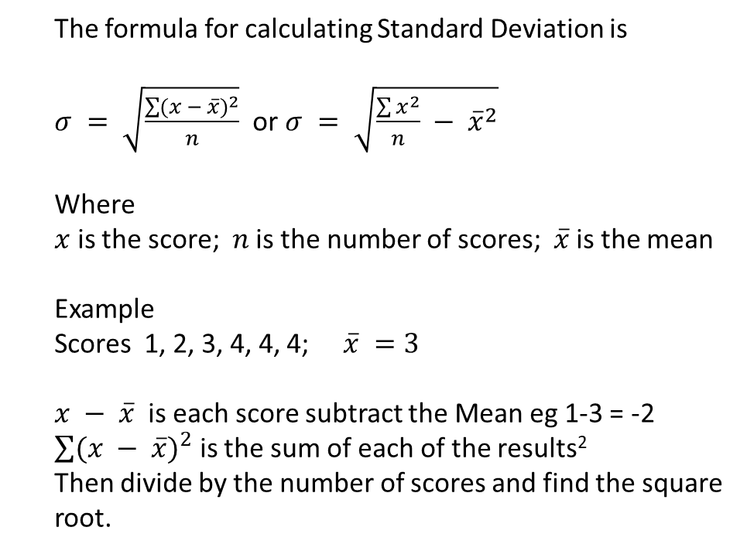
24
7
30
Date
Mean and Standard Deviation
EQ – How do you calculate Standard Deviation
How is Standard Deviation calculated
The formula for calculating Standard Deviation is
$σ = \sqrt{\frac{\sum{{(x − \overline{x})}^{2}}}{n}}$ or $σ = \sqrt{\frac{\sum{x^{2}}}{n} − {\overline{x}}^{2}}$
Where
$x$ is the score; $n$ is the number of scores; $\overline{x}$ is the mean
Example
Scores 1, 2, 3, 4, 4, 4; $\overline{x} =3$
$x − \overline{x}$ is each score subtract the Mean eg 1-3 = -2
$\sum{{(x − \overline{x})}^{2}}$ is the sum of each of the results²
Then divide by the number of scores and find the square root.
5
Notes:
Work thru on board -2, -1, 0, 1, 1, 1; sum of squares = 8. divide by 6 1.3333333, square root = 1.154700538.

Slide 7
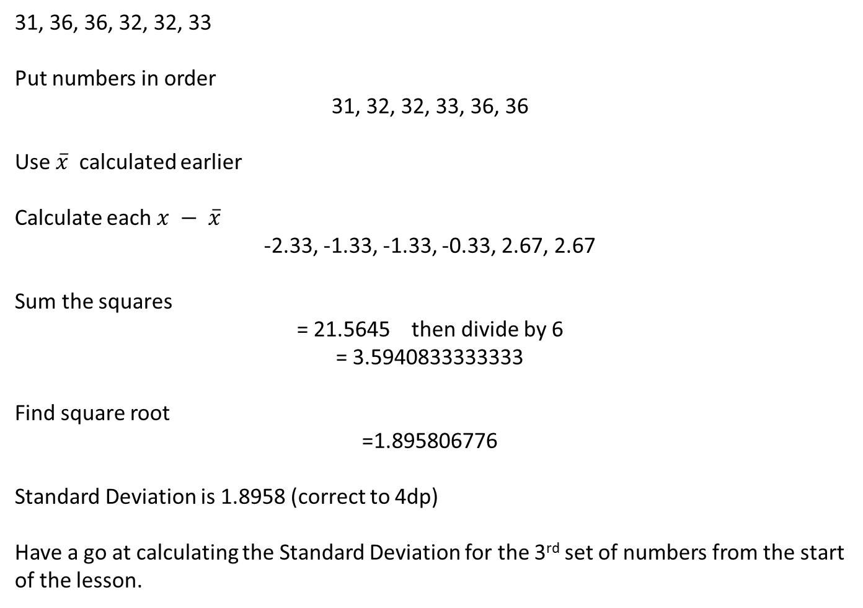
Guided Practice
31, 36, 36, 32, 32, 33
Put numbers in order
31, 32, 32, 33, 36, 36
Use $\overline{x}$ calculated earlier
Calculate each $x − \overline{x}$
-2.33, -1.33, -1.33, -0.33, 2.67, 2.67
Sum the squares
= 21.5645 then divide by 6
= 3.5940833333333
Find square root
=1.895806776
Standard Deviation is 1.8958 (correct to 4dp)
Have a go at calculating the Standard Deviation for the 3rd set of numbers from the start of the lesson.
Notes:
Mean = 33.33 Std Dev from set 3 = 0.19472026594

Slide 8
24
7
30
Date
Mean and Standard Deviation
EQ – How do you calculate Standard Deviation
Calculate using Casio fx-82AU Plus II
Press mode - select 2:STAT - select 1:1-VAR
Screen should have 1 column with heading ‘X’
Press Shift-setup, down arrow select 3:stat - 1:on
You now have 2 columns ‘X’ and ‘FREQ’
Enter – 1=2=3=4= (enters scores)
Arrow up (to highlight 4) arrow right to FREQ enter 3=
The scores and their frequencies have been entered for use
Press AC, goes back to usual screen
5
Notes:
Input

Slide 9
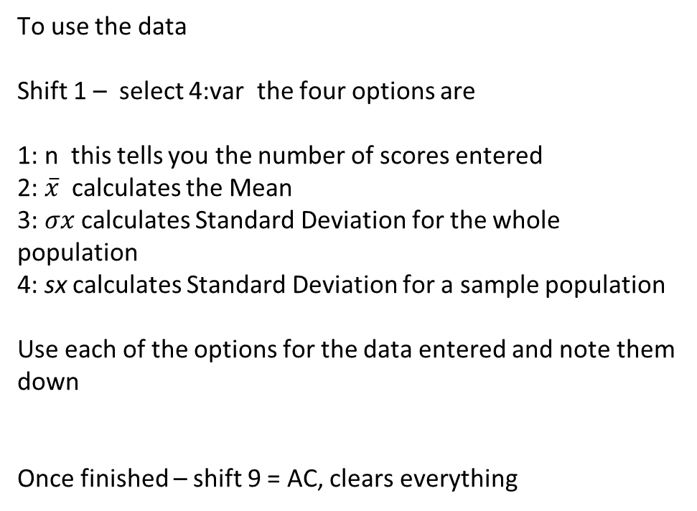
24
7
30
Date
Mean and Standard Deviation
EQ – How do you calculate Standard Deviation
To use the data
Shift 1 – select 4:var the four options are
1: n this tells you the number of scores entered
2: $\overline{x}$ calculates the Mean
3: $σx$ calculates Standard Deviation for the whole population
4: sx calculates Standard Deviation for a sample population
Use each of the options for the data entered and note them down
Once finished – shift 9 = AC, clears everything
5
Notes:
Input

Slide 10
Activity
Practice using the calculator using the other 3 datasets from the start of this lesson.
Dwyer Page 180 Ex13.9
Notes:
Independent practice

Slide 11
24
7
30
Date
Mean and Standard Deviation
EQ – How do you calculate Standard Deviation
5
Notes:
Input

Slide 12
Check for understanding
Notes:
Check for understanding

Slide 13
Guided Practice
Notes:
Guided practice

Slide 14
Closure activity
Success Criteria
Thumbs up etc
Notes:
Closure

